Slide 1
Unit 5 IMAGE COMPRESSION(6hrs)
Presented By
Er.Harendra Bikram Shah
(Lecturer)
Department of Computer Engineering

Slide 2
OUTLINES
5.1. Coding Redundancy
5.1.1. Huffman Coding
5.2. Interpixel Redundancy
5.2.1. Run length Coding
5.3. Psychovisual Redundancy
5.4. Image Compression Models
5.5. Lossless and Lossy Compressions
5.5.1. Predictive Coding

Slide 3
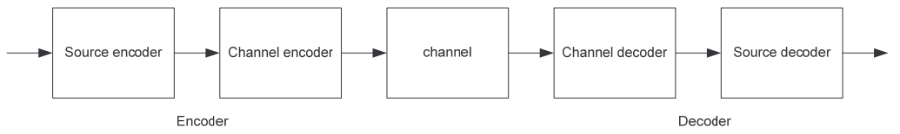
Introduction to Image Compression Model
process of reducing the size of an image file while retaining as much visual quality as possible.
This is important for efficient storage, transmission, and processing of images.
There are two main types of image compression: lossless and lossy.
Applications of Image Compression:
Medical Imaging:
Video Conferencing:
Satellite imagery:
Social Media:
Digital Photography:

Slide 4

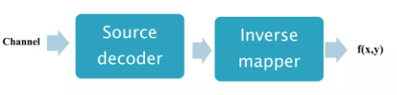

Slide 5
Redundancies in Image Compression
Spatial Redundancy/Inter-Pixel Redundancy/Intraframe Coding:
refers to similarities or patterns in pixel values within the same image.
Compression techniques Used are Run-Length Encoding (RLE) or predictive coding.
Temporal Redundancy/Interframe Coding(in Video Compression):
occurs when consecutive frames in a video sequence share similarities.
Compression Technique: inter-frame prediction and motion compensation.
Color Redundancy:
arises when there are correlations among Color components in an image.
Compression Technique: Color space transformations and chroma subsampling(Less resolution Technique)
Psychovisual Redundancy:
based on the limitations of the human visual system.
Compression Technique: JPEG compression.
Statistical Redundancy:
related to the probability distribution of pixel values in an image.
Compression Technique: Huffman coding
Transform Redundancy:
arises when there are correlations in the spatial domain that can be better represented in a transformed domain.
Compression Technique: JPEG compression

Slide 6
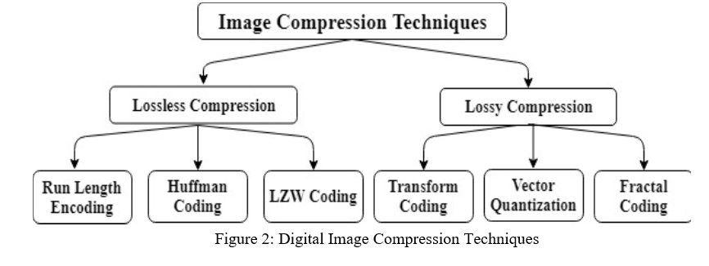

Slide 7
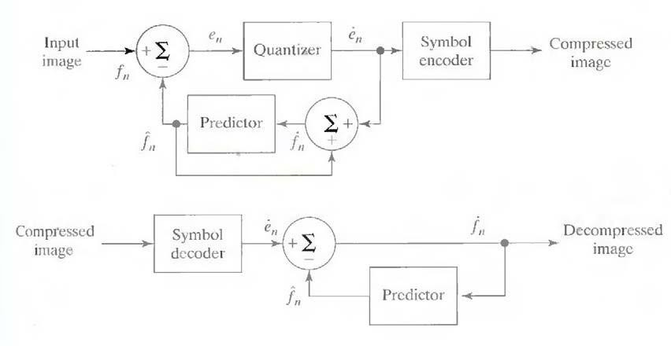
Lossy Predictive Coding

Slide 8
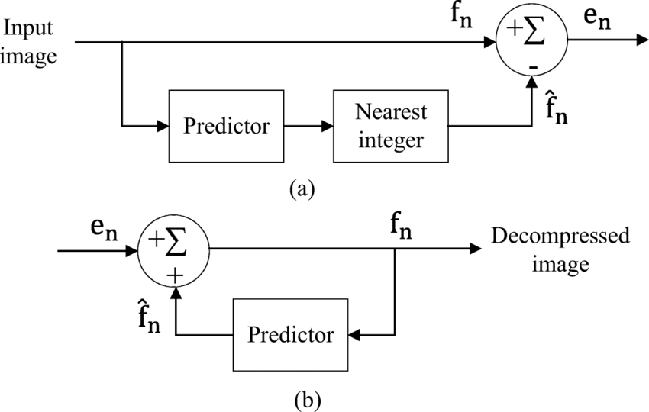
Lossless Predictive Coding
Symbol Encoder
Compressed
Image
Compressed
Image
Symbol Decoder

Slide 9
Numerical of Huffman Coding

Slide 10
End of UNIT 5

Slide 11
THANK YOU

